Slide 1
Introduction to PCL - What can we do with point cloud data?
MAE683, Human Robot Interaction
Seung-Chan Kim
March 18th, 2014

Slide 2
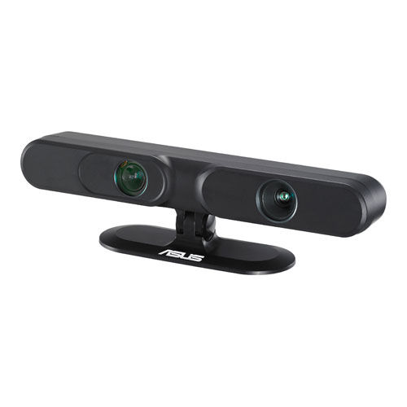
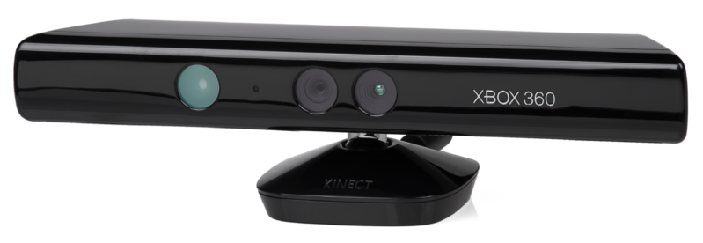
What is point cloud ?
A point cloud is a set of data points in some coordinate system.
…
Xtion PRO
Microsoft Kinect

Slide 3
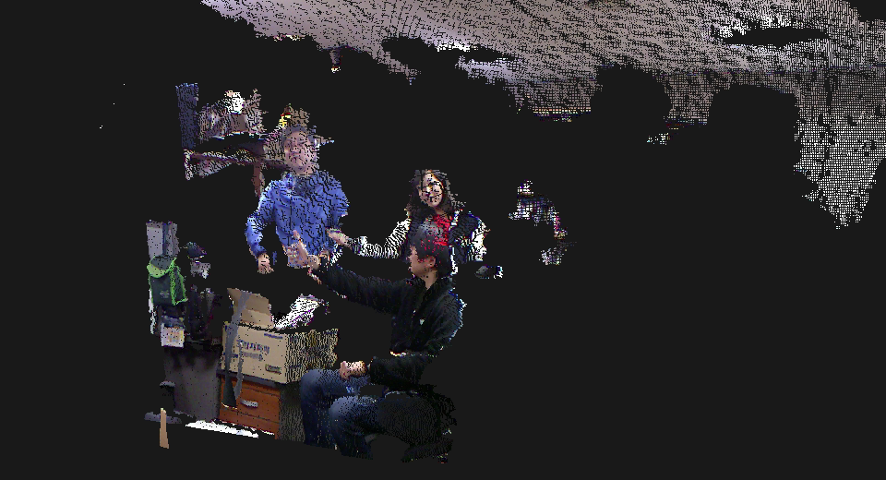
Example of point cloud data

Slide 4
How to deal with the massive point clouds ?!
Notes:
From scratch ? No !!!

Slide 5
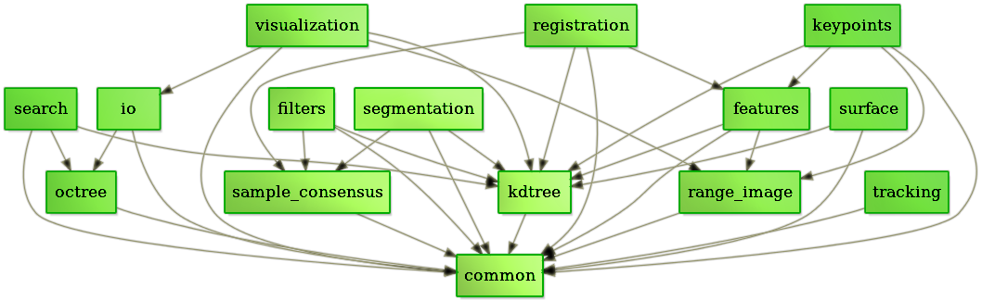
What is Point Cloud Library (PCL) ?
PCL is a large scale, open project for 3D point cloud processing
The PCL framework contains numerous state-of-the art algorithms including filtering, feature estimation, surface reconstruction, registration, model fitting and segmentation.
http://pointclouds.org/about/

Slide 6

Who is developing PCL?

Slide 7
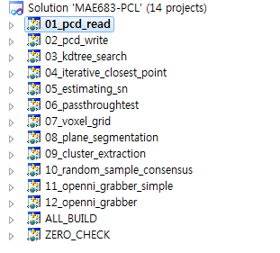
The PCL framework contains numerous state-of-the art algorithms
Use Project MAE683-PCL, which contains essential examples of PCL

Slide 8
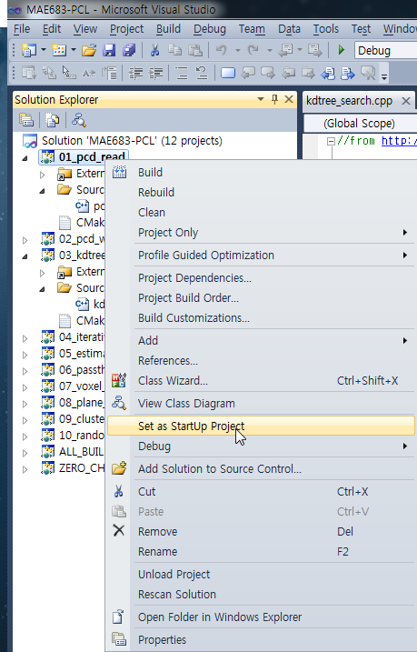

Slide 9
PCD File I/O
PCD (Point Cloud Data) file format
Try
01_pcd_read
02_pcd_write
Loaded 10 data points from test_pcd.pcd with the following fields:
1.1 1.2 1.3
2.1 2.2 2.3
3.1 3.2 3.3
4.1 4.2 4.3
5.1 5.2 5.3
6.1 6.2 6.3
7.1 7.2 7.3
8.1 8.2 8.3
9.1 9.2 9.3
10.1 10.2 10.3

Slide 10
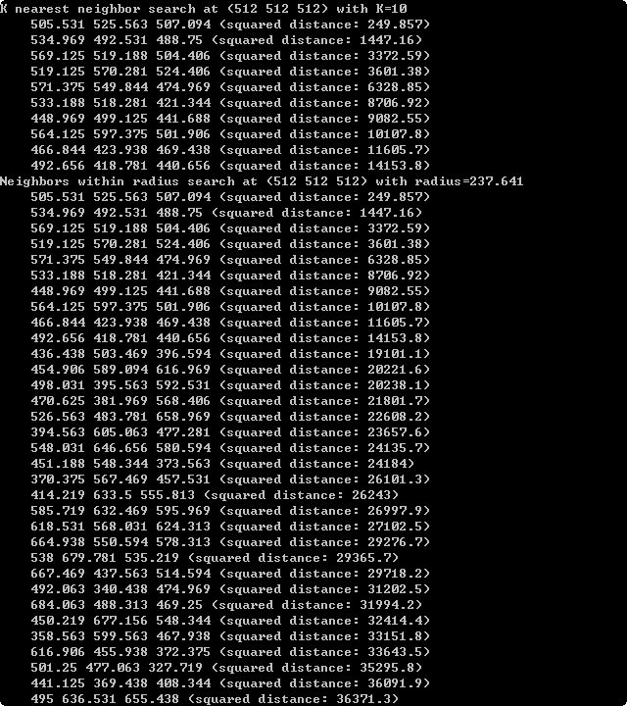
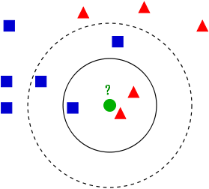
Finding the K-nearest neighbors?
KdTree is used for finding the K nearest neighbors of a specific point or location
Try 03_kdtree_search !

Slide 11
ICP(iterative closest point)
An algorithm employed to minimize the difference between two clouds of points.
ICP is often used
to reconstruct 2D or 3D surfaces from different scans,
to localize robots and achieve optimal path planning (especially when wheel odometry is unreliable due to slippery terrain),
to co-register bone models, etc.
For more information
http://www.asl.ethz.ch/education/master/info-process-rob/ICP.pdf
Notes:
Saved 5 data points to input:
36.875 464.438 721.875
242.688 908.344 392.656
511.25 2.125 457
251.406 1006.72 278.875
691.656 842.875 307.969
size:5
Transformed 5 data points:
37.575 464.438 721.875
243.387 908.344 392.656
511.95 2.125 457
252.106 1006.72 278.875
692.356 842.875 307.969
has converged:1 score: 1.25615e-006
1 -1.59978e-007 -4.06864e-008 0.69922
-2.05472e-007 1 -1.21336e-008 -0.00158703
-8.47061e-007 -3.95886e-007 1 0.000396208
0 0 0 1
http://www.asl.ethz.ch/education/master/info-process-rob/ICP.pdf

Slide 12
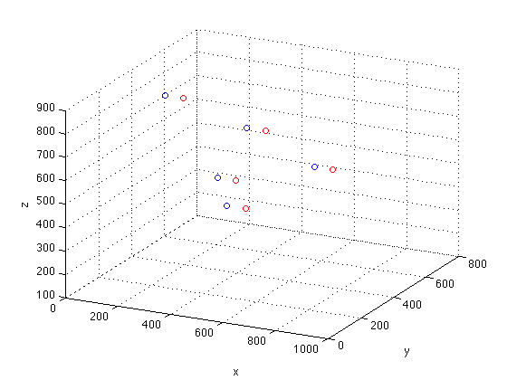
ICP(iterative closest point)
Notes:
clc; close all; clear;
A=[
134.219 389.281 817.469
830.219 187.594 722.313
117.219 796.75 164.781
258.125 693.25 568
226.906 562.219 407.813
];
B = [
204.219 389.281 817.469
900.219 187.594 722.313
187.219 796.75 164.781
328.125 693.25 568
296.906 562.219 407.813
];
figure
plot3(A(:,1), A(:,2), A(:,3),'o');
hold on;
plot3(B(:,1), B(:,2), B(:,3),'ro');
grid;
xlabel('x');
ylabel('y');
zlabel('z')

Slide 13
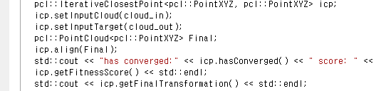
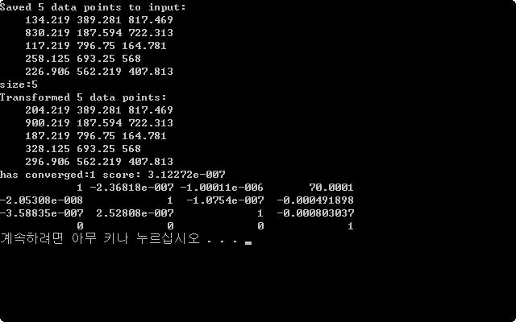
Try 04_iterative_closest_point

Slide 14
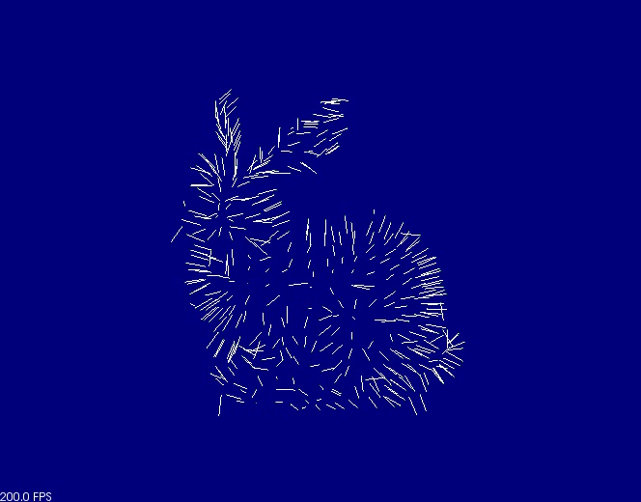
Estimating Surface Normals in a PointCloud
05_estimating_sn
Notes:
Surface normals are important properties of a geometric surface, and are heavily used in many areas such as computer graphics applications, to apply the correct light sources that generate shadings and other visual effects.

Slide 15
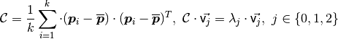
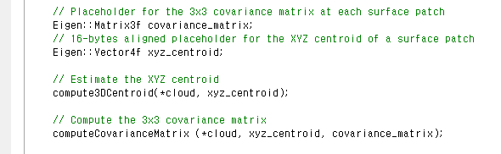
Estimating “a covariance matrix” from a set of points is essential for estimating surface normals
Notes:
http://pointclouds.org/documentation/tutorials/normal_estimation.php

Slide 16
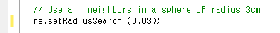
Estimating Surface Normals in a PointCloud
The solution for estimating the surface normal
=
an analysis of the eigenvectors and eigenvalues (or PCA) of a covariance matrix created from the nearest neighbors of the query point.

Slide 17
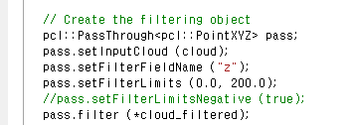
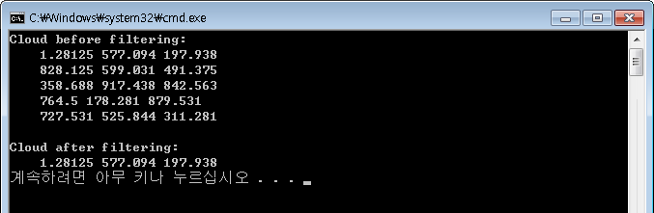
Cutting off values that are either inside or outside a given user range
PassThrough filter - a simple filtering along a specified dimension
0<z<200
06_passthroughtest

Slide 18
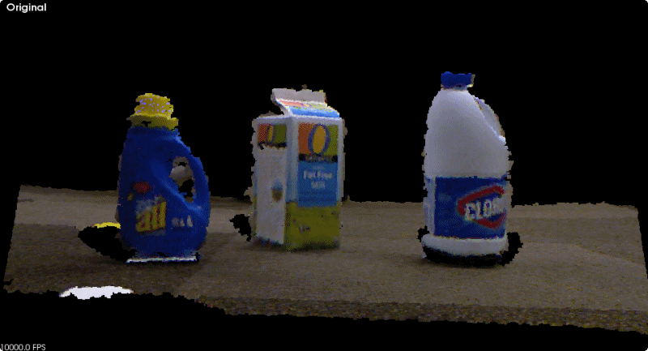
Downsampling a PointCloud using a VoxelGrid filter
07_voxel_grid
./res/milk_cartoon_all_small_clorox.pcd
Notes:
http://www.pointclouds.org/documentation/tutorials/voxel_grid.php

Slide 19
What Is a Voxel?
A voxel represents a value on a regular grid in three-dimensional space. Voxel is a combination of "volume" and "pixel" where pixel is a combination of "picture" and "element".
a box, rather than a point, in space that has a volume

Slide 20
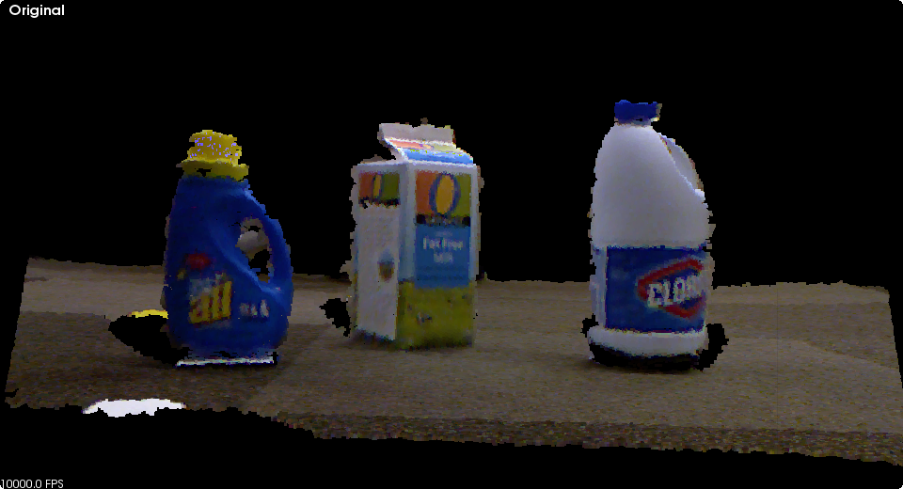
Plane model segmentation: How to find all the points within a point cloud that support a plane model ?
08_plane_segmentation

Slide 21
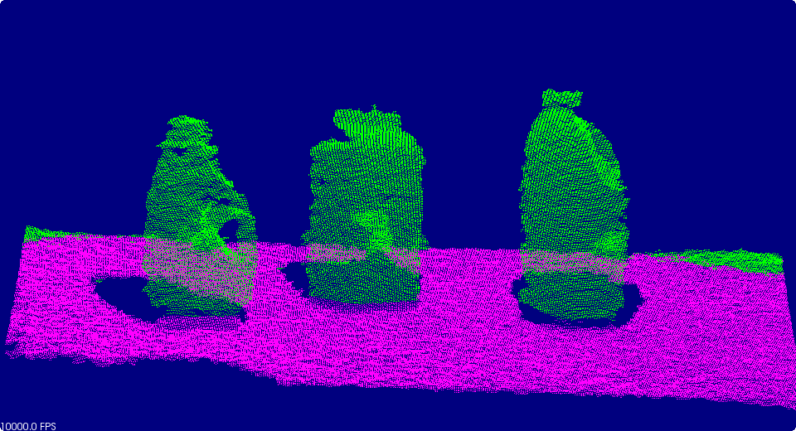
Plane model segmentation: How to find all the points within a point cloud that support a plane model ?
Loaded 307200 data points from test_pcd.pcd
Point cloud data: 307200 points
Model coefficients: 0.00601627 -0.821575 -0.570068 0.463954
Plane: 0.00601627x-0.821575y-0.570068z+0.463954=0
Model inliers: 196818
Notes:
http://www.pointclouds.org/documentation/tutorials/planar_segmentation.php

Slide 22
RANSAC for estimating parameters of a mathematical model from a set of data containing outliers
RANSAC (RANdom SAmple Consensus)
An iterative method that is used to estimate parameters of a meathematical model from a set of data containing outliers !
The RANSAC algorithm assumes that all of the data we are looking at is comprised of both inliers and outliers.
http://pointclouds.org/documentation/tutorials/random_sample_consensus.php
Notes:
Fischler and Bolles in 1981
The input to the RANSAC algorithm is a set of observed data values

Slide 23
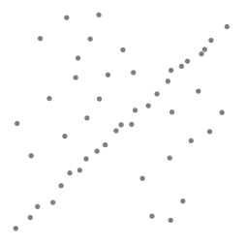
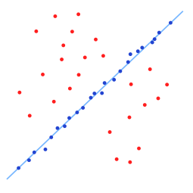
RANSAC for estimating parameters of a mathematical model from a set of data containing outliers
The distribution of inliers can be explained by a set of parameters and a model. The outlying data does not fit the model.
http://pointclouds.org/documentation/tutorials/random_sample_consensus.php
Notes:
Fischler and Bolles in 1981
The input to the RANSAC algorithm is a set of observed data values

Slide 24
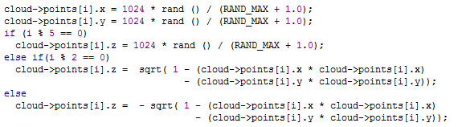
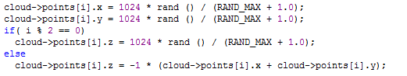
RANSAC for estimating parameters of a mathematical model from a set of data containing outliers
Sphere with noise
Plane with noise

Slide 25
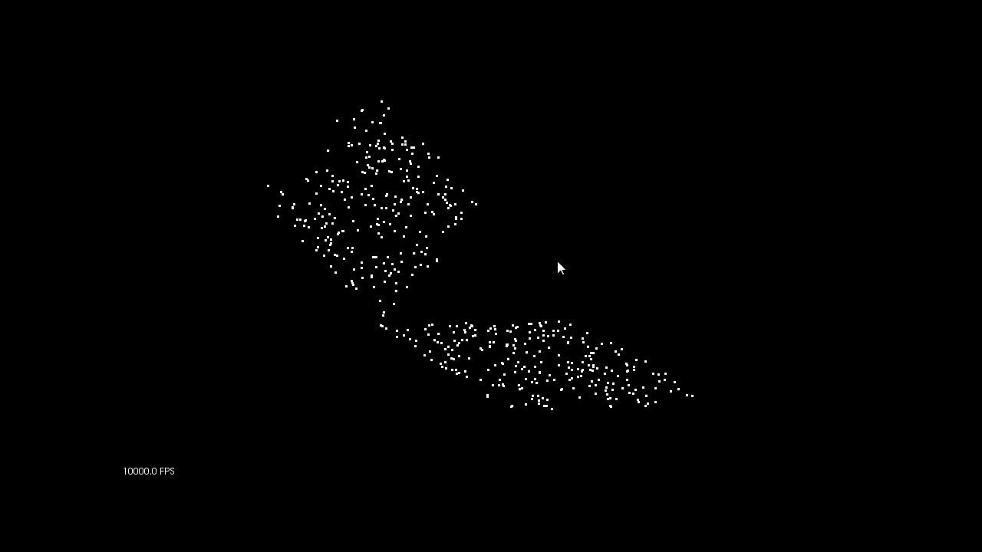
RANSAC for estimating parameters of a mathematical model from a set of data containing outliers

Slide 26
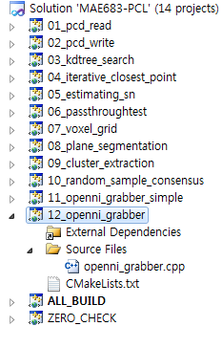
Install and try the examples !
Put your stuff in the project named 12_openni_grabber !!!
http://robot.kaist.ac.kr/~kimsc/MAE683/example/
Notes:
/home/kimsc/public_html/MAE683/example

Slide 27
Thank you !

Slide 28
Installation of PCL

Slide 29
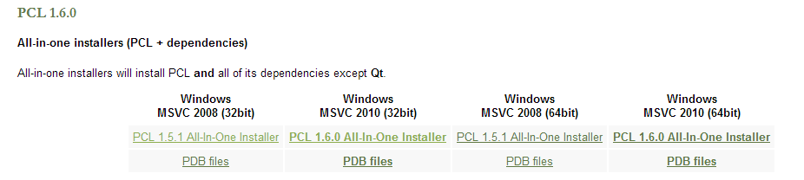
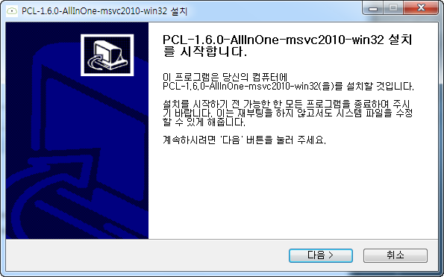
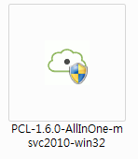
http://pointclouds.org/downloads/

Slide 30
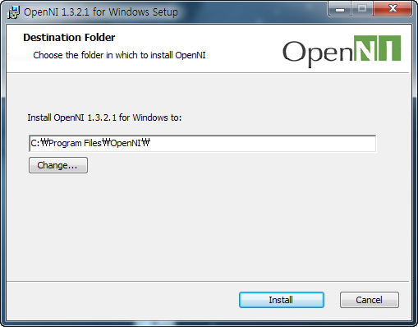

Slide 31
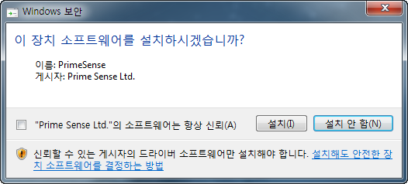

Slide 32
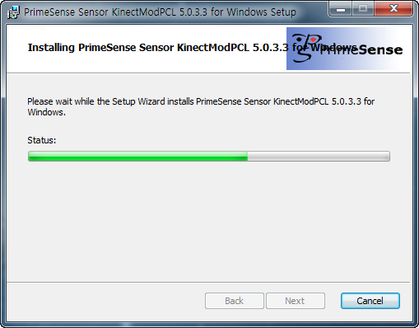

Slide 33
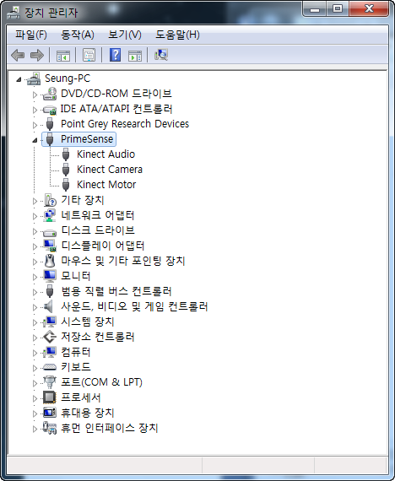

Slide 34
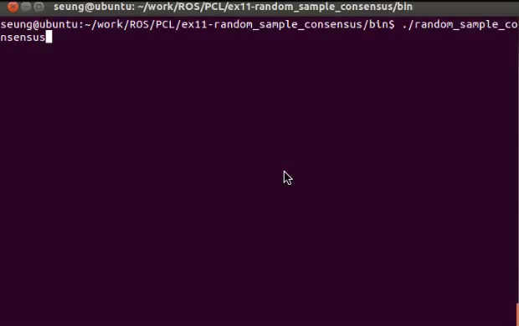
Notes:
10_random_sample_consensus.exe –f

Slide 35
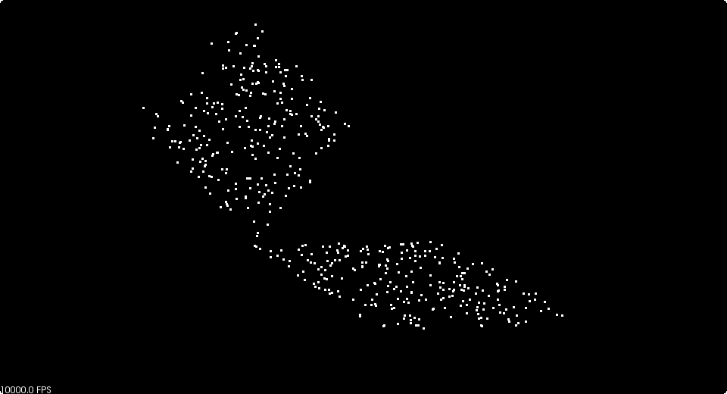
10_random_sample_consensus.exe

Slide 36
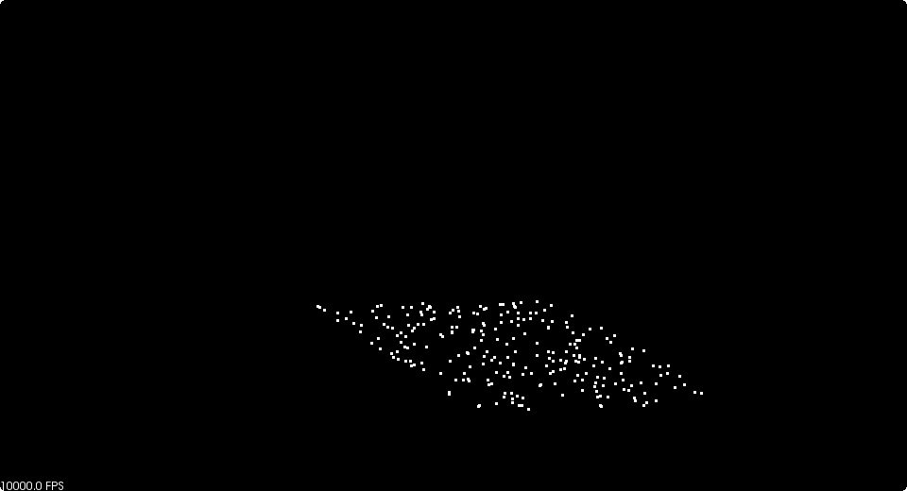
10_random_sample_consensus.exe -f

Slide 37
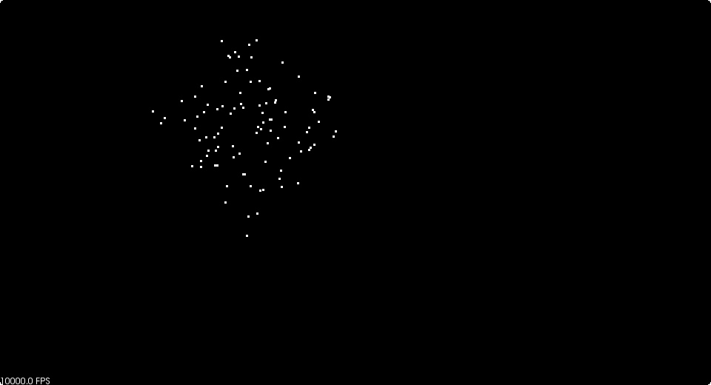
10_random_sample_consensus.exe -s

